Slide 1
Understanding r/Depression and r/SuicideWatch
Are these communities viable support resources for at-risk individuals?

Slide 2
Depression and Suicide
01
02
The Depression and Suicide Watch Subreddits
TABLE OF CONTENTS
Goals and Methodology
03
04
05
Classifying Threads
Quantifying the Data
06
Conclusions

Slide 3
01
Depression and Suicide

Slide 4
A Leading Cause of Disability in U.S. Adults
Strongly correlated with anxiety and panic disorders
Major Depressive Disorder
An overwhelming feeling of sadness or a loss of interest in most activities
Half of all suicide victims suffer from MDD
Affects over 16 million U.S. adults every year

Slide 5
How Suicide Impacts Us
1.3%
2nd
123
Of U.S. deaths are suicide-related
Leading cause of death, ages 15 - 34
Suicides per day

Slide 6
02
The Depression and Suicide Watch Subreddits

Slide 7

The r/Depression Subreddit
“Peer support for anyone struggling with depression, the mental illness”
Text posts only
No diagnoses allowed
“We are not a crisis service. We can’t guarantee an immediate response.”
579,000 members
Nothing explicit about self-harm
“It’s usually more helpful to post anything that specifically involves suicidal intent in r/SuicideWatch”
Created Jan 1, 2009
Support, rather than advice

Slide 8
The r/SuicideWatch Subreddit
“This is a place of support”
Direct, personal, supportive
No diagnoses allowed
“If you’re here to help, please respond publicly to our OPs in need”
172,000 members
Non-judgmental comments only
Talking Tips and Risk Assessment guides provided for community
Created Dec 16, 2008
No pro-suicide posts allowed

Slide 9
03
Goals, Methodology, and Data

Slide 10
Goals and Objectives:
Quantify the environments of these communities
Sentiment
Word Usage
How supportive are commenters towards posters?
Do posters and commenters employ particular strategies when engaging in the r/Depression and r/SuicideWatch communities?

Slide 11
Goals and Objectives:
Identify fundamental differences between the subreddits
Thread Metadata
Classification
In what ways do r/Depression Threads differ from r/SuicideWatch Threads?
Can we distinguish posts involving depression from posts involving suicide?

Slide 12
Dataset Overview
r/Depression
r/SuicideWatch
934 threads
980 threads
Threads and comments pulled from Reddit using PRAW
4,035 comments
4,447 comments

Slide 13
04
Quantifying the Subreddits

Slide 14
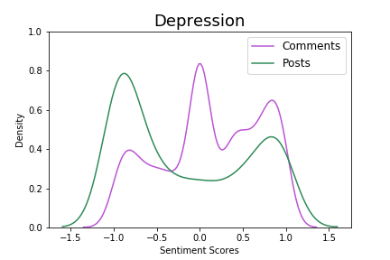
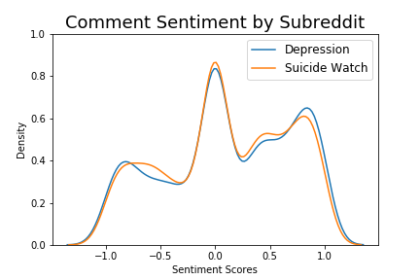
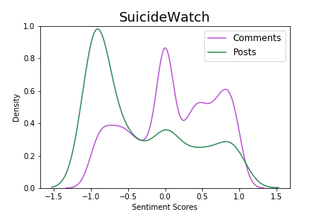
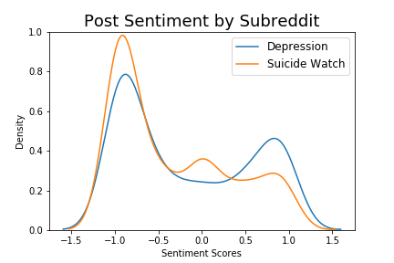
Sentiment Analysis

Slide 15
Sentiment Analysis
r/Depression posts are usually either very negative or very positive, though most posts are negative.
The comments are much more positive than the posts, which indicates that commenters tend to foster more positive environments.
Additionally, some comments are very negative. This is not necessarily a bad thing; many of these negative comments could be validating the original poster’s feelings.

Slide 16
Sentiment Analysis
A similar dynamic exists in r/SuicideWatch, though the posts are drastically more negative. This fits with the intuition we have about this subreddit. Posts here are much more likely to be strongly negative than posts in r/Depression.
Notes:
Alternatively, these commenters could be sympathizing with the OP and are reaching out to the community for help in this pre-established thread, rather than creating an entirely new post.

Slide 17
Sentiment Analysis
Comparing the subreddits, we see very similar behaviors, though comments in r/SuicideWatch tend to be somewhat more neutral.
Notes:
The big differences in sentiment scores from here on out are going to be predominantly due to the posts, not the comments.
I was surprised that the comment sentiments on both subreddits are so similar; I had guessed that r/SuicideWatch would have a much more skewed left sentiment distribution.

Slide 18
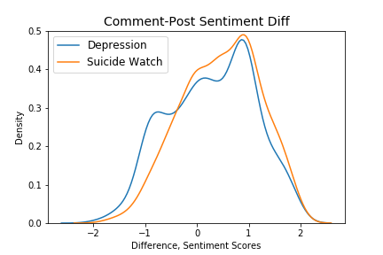
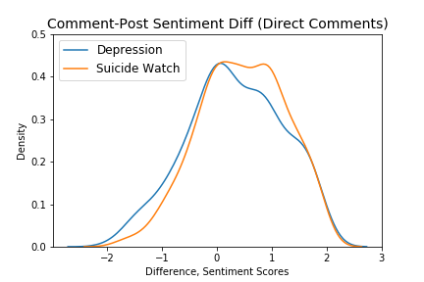
Sentiment Analysis – Posters and Commenters

Slide 19
Sentiment Analysis – Posters and Commenters
This density plot shows the distribution of the difference between the median comment sentiment and the post sentiment. (A positive value means the median comment sentiment was more positive than the post.)
In general, in both subreddits, the average comment has a higher sentiment score than the post that comment responded to.

Slide 20
Sentiment Analysis – Posters and Commenters
This plot excludes comments that were not direct responses to the original post.
There is a greater difference in sentiments in this plot than in the plot on the left, which means that direct responders are much more likely to respond in very positive and constructive ways.

Slide 21
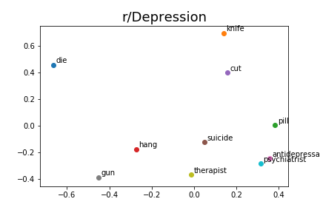
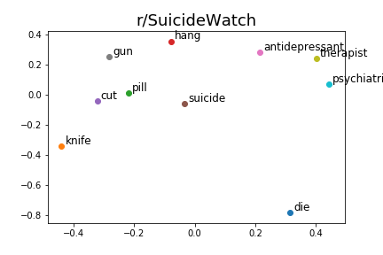
Identifying Commenting Strategies
Notes:
The greater the distance between two points, the less often those words occur together
The points on the r/Depression plot are somewhat evenly spread out, which indicates there isn’t much meaningful correlation among these words.
The points on the r/SuicideWatch plot form two clusters: one pertaining to medical intervention and another pertaining to suicide-related words. This indicates that there are two distinct groups of posters on this subreddit. One consistently recommends a plethora of medical solutions to suicide-prone individuals. The other is likely expressing solidarity with the poster about their desire to commit suicide (as posts and comments promoting suicide are banned from the subreddit).
A big difference between these two plots is that, in r/Depression, suicide has a high lift with therapist, psychiatrist, and antidepressant. However, in r/SuicideWatch, suicide has a high lift with acts of suicide. An r/SuicideWatch post is more likely to contain elements of ideation of suicide.

Slide 22
Identifying Commenting Strategies
Notes:
The greater the distance between two points, the less often those words occur together
The points on the r/Depression plot are somewhat evenly spread out, which indicates there isn’t much meaningful correlation among these words.
The points on the r/SuicideWatch plot form two clusters: one pertaining to medical intervention and another pertaining to suicide-related words. This indicates that there are two distinct groups of posters on this subreddit. One consistently recommends a plethora of medical solutions to suicide-prone individuals. The other is likely expressing solidarity with the poster about their desire to commit suicide (as posts and comments promoting suicide are banned from the subreddit).
A big difference between these two plots is that, in r/Depression, suicide has a high lift with therapist, psychiatrist, and antidepressant. However, in r/SuicideWatch, suicide has a high lift with acts of suicide. An r/SuicideWatch post is more likely to contain elements of ideation of suicide.

Slide 23
Identifying Commenting Strategies
Notes:
The greater the distance between two points, the less often those words occur together
The points on the r/Depression plot are somewhat evenly spread out, which indicates there isn’t much meaningful correlation among these words.
The points on the r/SuicideWatch plot form two clusters: one pertaining to medical intervention and another pertaining to suicide-related words. This indicates that there are two distinct groups of posters on this subreddit. One consistently recommends a plethora of medical solutions to suicide-prone individuals. The other is likely expressing solidarity with the poster about their desire to commit suicide (as posts and comments promoting suicide are banned from the subreddit).
A big difference between these two plots is that, in r/Depression, suicide has a high lift with therapist, psychiatrist, and antidepressant. However, in r/SuicideWatch, suicide has a high lift with acts of suicide. In r/SuicideWatch, there is evidence of ideation of suicide, a strong indicator of suicide.

Slide 24
05
Classifying Threads

Slide 25
How Posts Differ Across Subreddits
 | Median Direct Reply Time¹ | Minimum Reply Time | Median Comment Length² | Post Sentiment Score
Depression | 182 | 46 | 30 | - 0.17
SuicideWatch | 444 | 294 | 33 | - 0.33
1. Measured in minutes
2. Word counts of comments
Notes:
Measurements are averages of all posts for each subreddit
The increased time to reply in r/SuicideWatch is likely due to the lower population

Slide 26
Classifying Threads
Logistic Regression
Accuracy: 70.1%
False Pos Rate: 33%
False Neg Rate: 23%
Median Direct Reply Time
Min Reply Time
Post Sentiment Score
Median Comment Length
Frequency of Suicide-related Words
Frequency of Goal-oriented Words
Feature Importance
Gradient Boosting
Accuracy: 64%
False Pos Rate: 29%
False Neg Rate: 52%
Notes:
TFIDF was ineffective in correctly assigning threads to r/Depression and r/SuicideWatch.
The data used here were metadata regarding the threads and sentiment scores of post bodies and comments

Slide 27
06
Conclusions

Slide 28

What we can conclude about these subreddits
There is evidence that commenters generally create more positive environments for communities
2.
Commenters on r/SuicideWatch tend to either discuss medical intervention solutions or express their urges regarding suicide
3.
There is evidence that a distinguishing factor between r/Depression and r/SuicideWatch commenters is ideation of suicide
4.
Comment time and post sentiment scores are the distinguishing factors of these communites
Notes:
I do not want to make a recommendation for or against using these subreddits as solutions or alternatives for individuals suffering from depression or who are at risk of suicide. The ultimate purpose of this project is to show that there is some evidence suggesting it could be beneficial.
I am not qualified to give a medical recommendation to anyone, and this analysis is not wide enough nor thorough enough for such a conversation.

